Slide 1
Monsoon & Macro Signals to Predict Stock Break-Out Final Presentation
Name: Abhilash Panicker
Mentor: Abhijit Chakraborty
Notes:
Student name - 2 marks
Mentor’s name - 2 marks
Topic name - 2 marks
-> automated grading

Slide 2
Executive Summary
Objective: Forecast next-quarter Midcap vs NIFTY excess return using monsoon rainfall + economic signals.
Why it matters: Weather and macro surprises often move markets; we test whether combining them improves timing for midcap exposure.
Data: India monsoon deviation from normal (IMD), inflation, GDP, policy rate, and index returns (2013–2025), aligned by quarter.
Approach: Compare a simple baseline (previous quarter’s return) to an expanded model (adds monsoon + macro). Walk-forward validation.
Result: No model beats naïve baselines on this sample. Recent relative performance (last quarter’s spread) carries the most usable signal. Macro variables (inflation, GDP, policy rate, monsoon) show weak, unstable lift at a quarterly horizon

Slide 3
Gap Analysis
Prior work links monsoon → GDP and macro → equity returns separately.
Gap: No applied business study combining monsoon + macro to forecast midcap excess return next quarter.
Business use: If a “good monsoon + supportive macro” reliably preceded stronger midcap quarters, allocators could tilt exposure tactically; policy teams could quantify climate sensitivity.

Slide 4
Research Questions
1) Does deviation in monsoon rainfall significantly correlate with Midcap breakouts?
Method: Pearson/Spearman; 12-Q rolling; partial correlations (trend/seasonality); lagged cross-correlation.
2) Which macroeconomic indicators best predict Midcap 100 breakouts? (considered: GDP growth YoY, policy-rate change in bps)
Method: Expanding-window CV (5 folds); compare Ridge, Lasso, GBR, RF vs naïve baselines; selection by RMSE.
3) Does a combined monsoon–macroeconomic model outperform models using single-signal inputs?
Method: Ablation in same CV (momentum-only, monsoon-only, macro-only, combined); compare RMSE.
4) Which features (e.g., lagged monsoon, repo-rate changes, GDP) have the highest predictive weight?
Method: Permutation importance on small holdout; drop-one ablation; L1/L2 sanity checks; partial correlations.

Slide 5
Data Description and EDA
Sources & scope
Rainfall: IMD, All-India monsoon deviation from normal (Jun–Sep), 2012–2025.
Gross Domestic Product(GDP): MoSPI(Institute), quarterly GDP growth (YoY, %), 2014–2025.
Policy rate: RBI, repo rate level and quarterly change (basis points), 2014–2025.
Indices: NSE Indices, NIFTY 50 & NIFTY Midcap 100 daily levels → quarterly returns, 2013–2025.
Frequency & alignment
All inputs aligned to calendar quarter-end.
Monsoon deviation stamped at Sep-30 each year and forward-filled until the next monsoon season.
Target is constructed on quarterly data.
Target variable
Next-quarter Midcap vs NIFTY outperformance (%) (i.e., Midcap quarterly return minus NIFTY quarterly return, predicted one quarter ahead.)
Features used at time T
Monsoon deviation (%), GDP growth (YoY, %), Policy rate change (bps),
Momentum: last-quarter spread & 4-quarter average,
Seasonality: quarter-of-year (sine/cosine).
Note: PMI was evaluated in the interim study and excluded from the final model due to very low incremental signal.

Slide 6
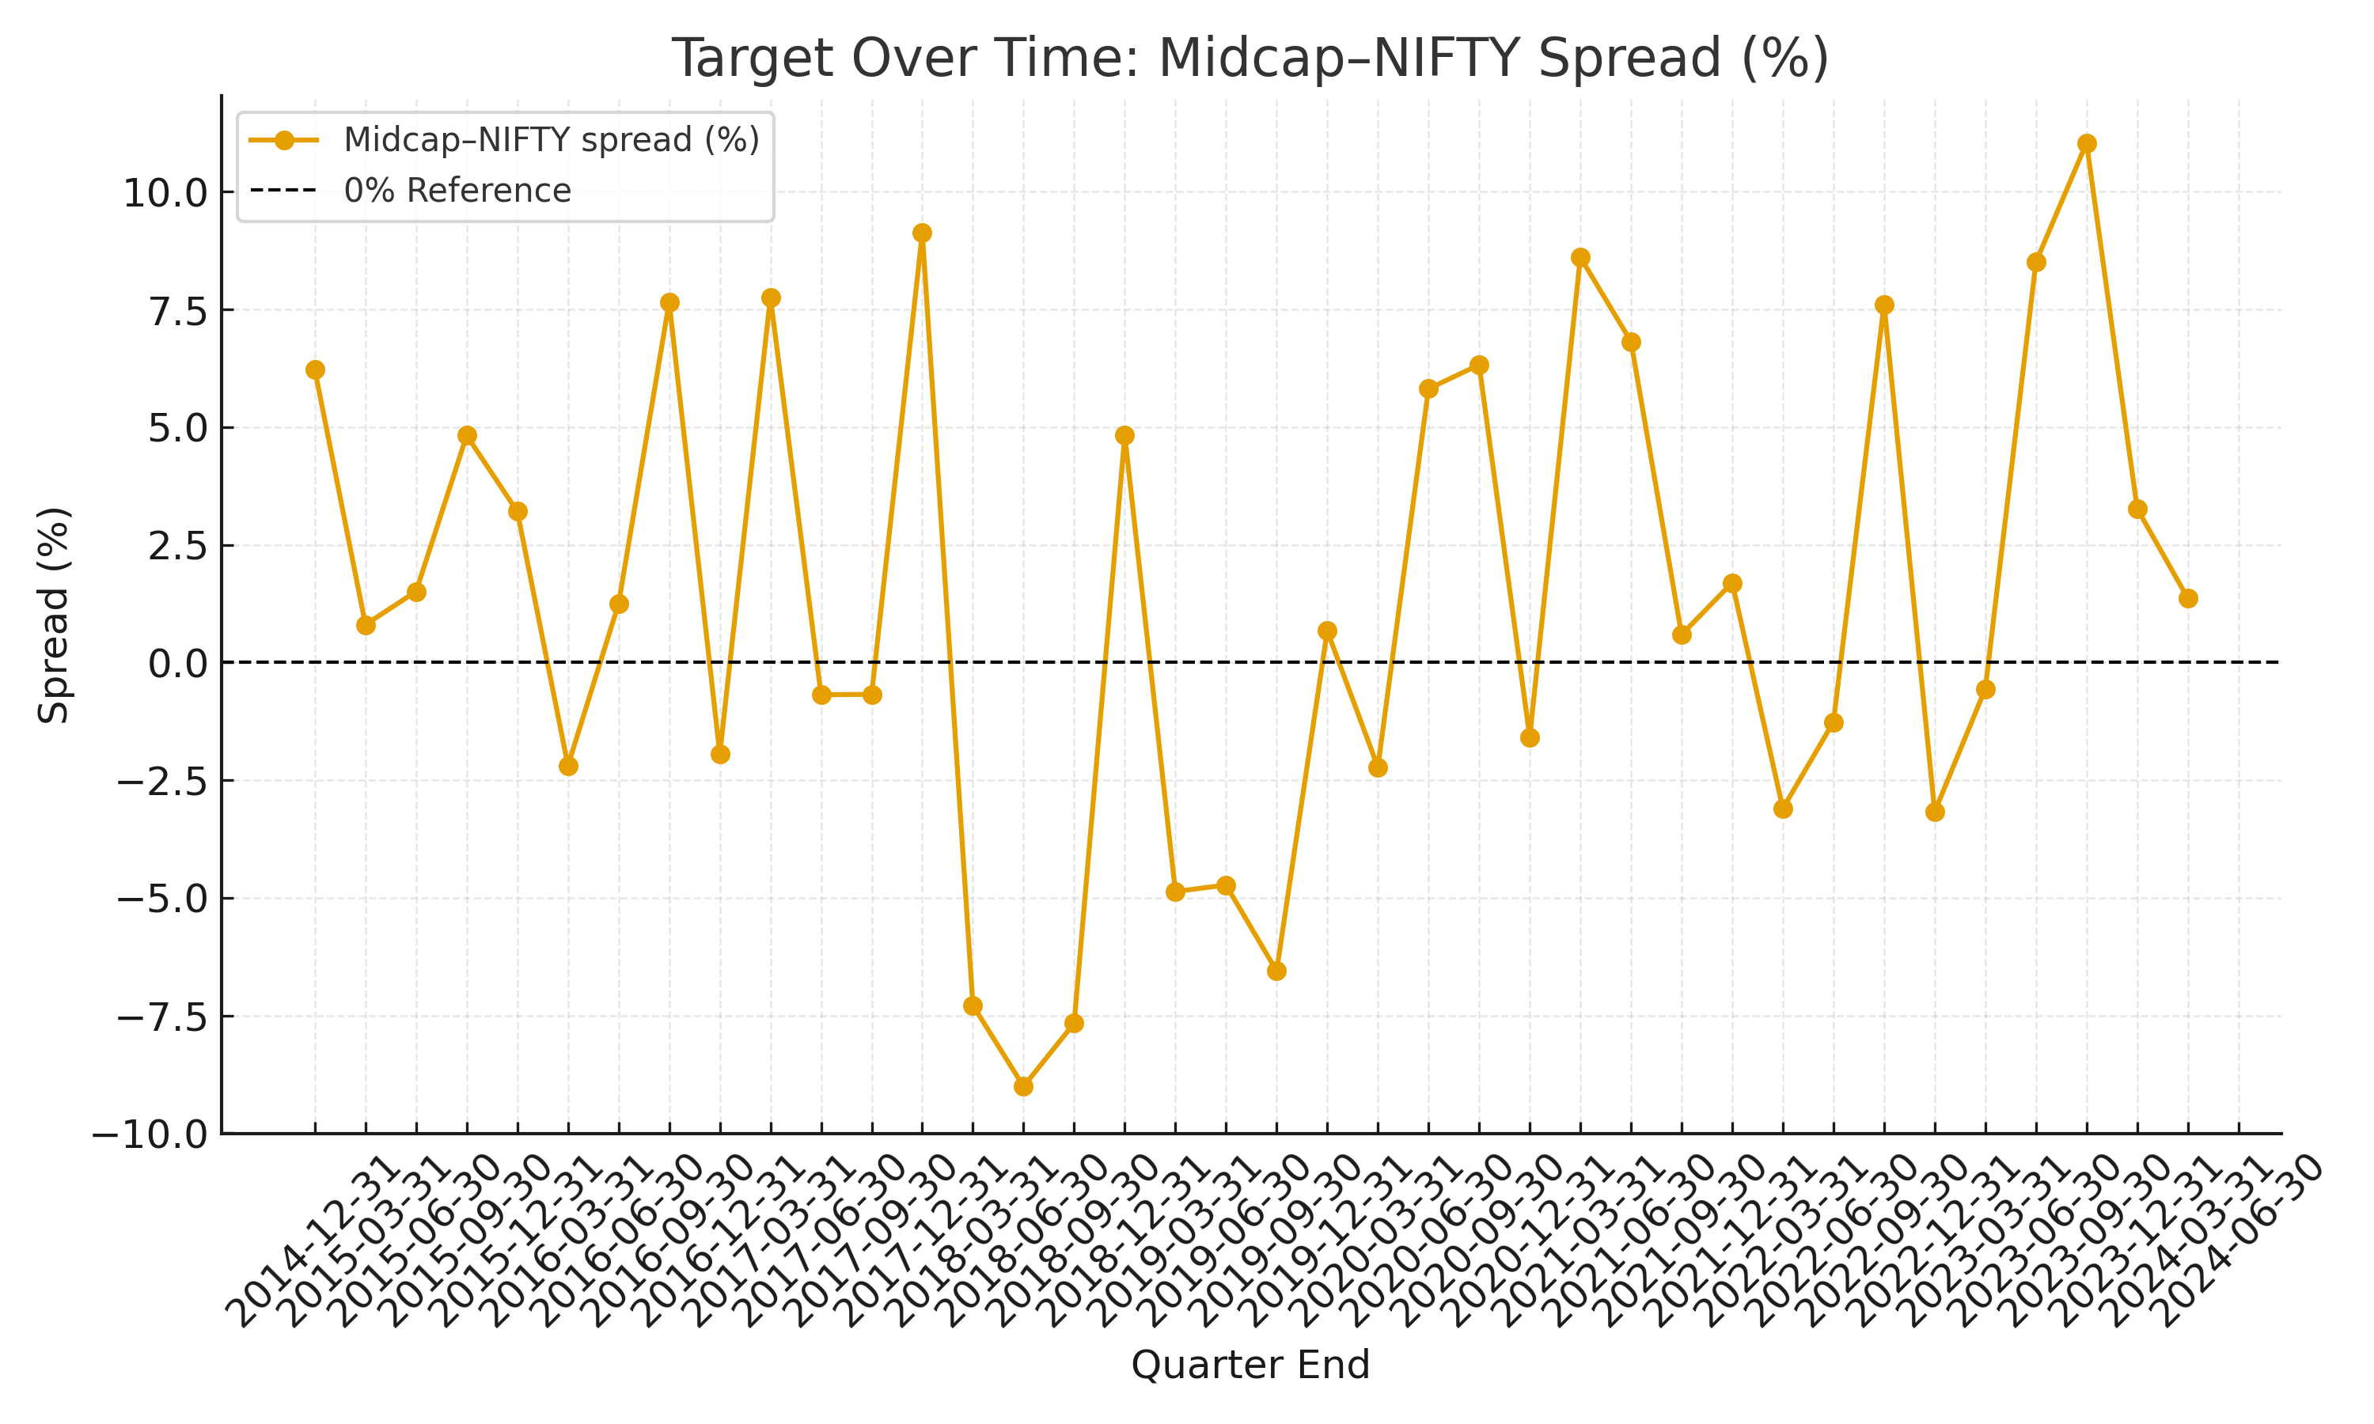
Data Description and EDA
The Midcap–NIFTY spread is the quarterly excess return of the Midcap index over the NIFTY benchmark.
This is the target variable we are modeling.
The chart shows historical spreads by quarter (positive = Midcaps outperform NIFTY, negative = underperform).
A 0% reference line is added for clarity:
Above line → Midcaps outperform
Below line → NIFTY outperforms
Takeaway: The spread exhibits clear fluctuations over time, supporting the need for predictive modeling.

Slide 7
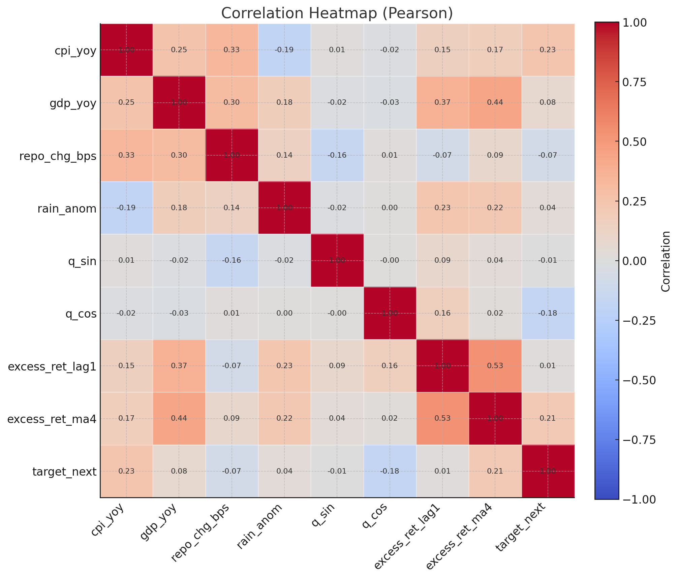
Data Description and EDA
Quarterly Pearson correlations. Most relationships are weak; the strongest with the target are still small (|r| ≲ 0.23).
Macro variables are modestly correlated with each other but not with next-quarter outperformance.

Slide 8
Architecture diagram/Workflow
Data Ingest
Quarter Alignment & QC
Feature Prep
Train Models
Walk-Forward Validation
IMD: monsoon (Jun–Sep)
MoSPI: GDP YoY
RBI: repo rate
NSE: NIFTY50 & Midcap100
Stamp to calendar quarter-end
Monsoon stamped Sep-30, carried
QC checks; avoid look-ahead
Momentum: lag-1, 4-Q avg
Monsoon deviation (%)
GDP growth (YoY, %)
Policy-rate Δ (bps)
Seasonality: quarter-of-year
Baselines: mean, lag-1
Ridge, Lasso, GBR, RF
Target: next-Q spread (T→T+1)
Expanding Timeseries Split (5)
Simulate deployment (unseen Qs)

Slide 9
Model building
Target (what we predict):
Next-quarter Midcap − NIFTY spread (%).
Features (available at time T): – Monsoon deviation (%) (IMD, Jun–Sep stamped Sep-30 and carried) – GDP growth (YoY, %); policy-rate change (bps) – Momentum: last-quarter spread; 4-quarter average – Seasonality: quarter-of-year (sin/cos)
Models compared:
Ridge, Lasso, Gradient Boosting, Random Forest vs naïve baselines (train-mean; lag-1 only).
Validation design:
Expanding TimeSeries Split (5 folds), no shuffling; features at T, target at T+1 to avoid look-ahead.
Evaluation:
primary RMSE; report MAE, R² as supporting metrics.

Slide 10
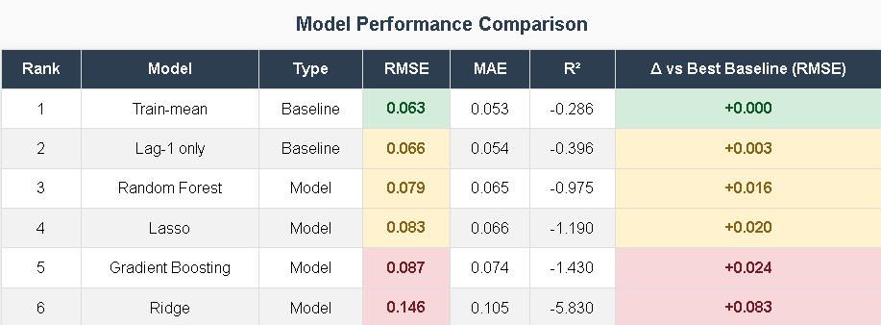
Results
On this dataset, simpler wins: the baseline makes more correct up/down calls
Adding a rainfall-based GDP improved the expanded model slightly, but still under the baseline.

Slide 11
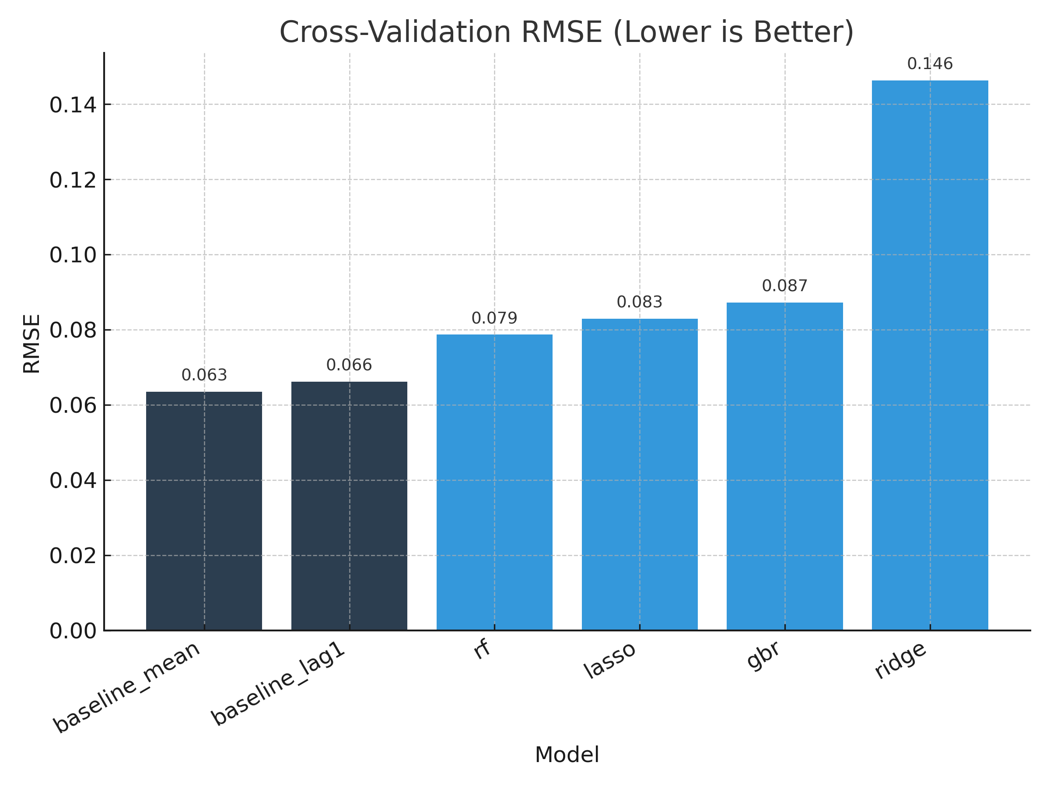
Results
Results – Cross-validation RMSE
Why it matters:
RMSE is the main accuracy metric (lower = better).
Benchmarks the models against simple baselines.
Key Findings:
Baselines (mean & lag-1) achieve the lowest RMSE.
All machine learning models (RF, Lasso, Gradient Boosting, Ridge) fail to beat baselines.
Indicates that macro signals add little value beyond naïve baselines.

Slide 12
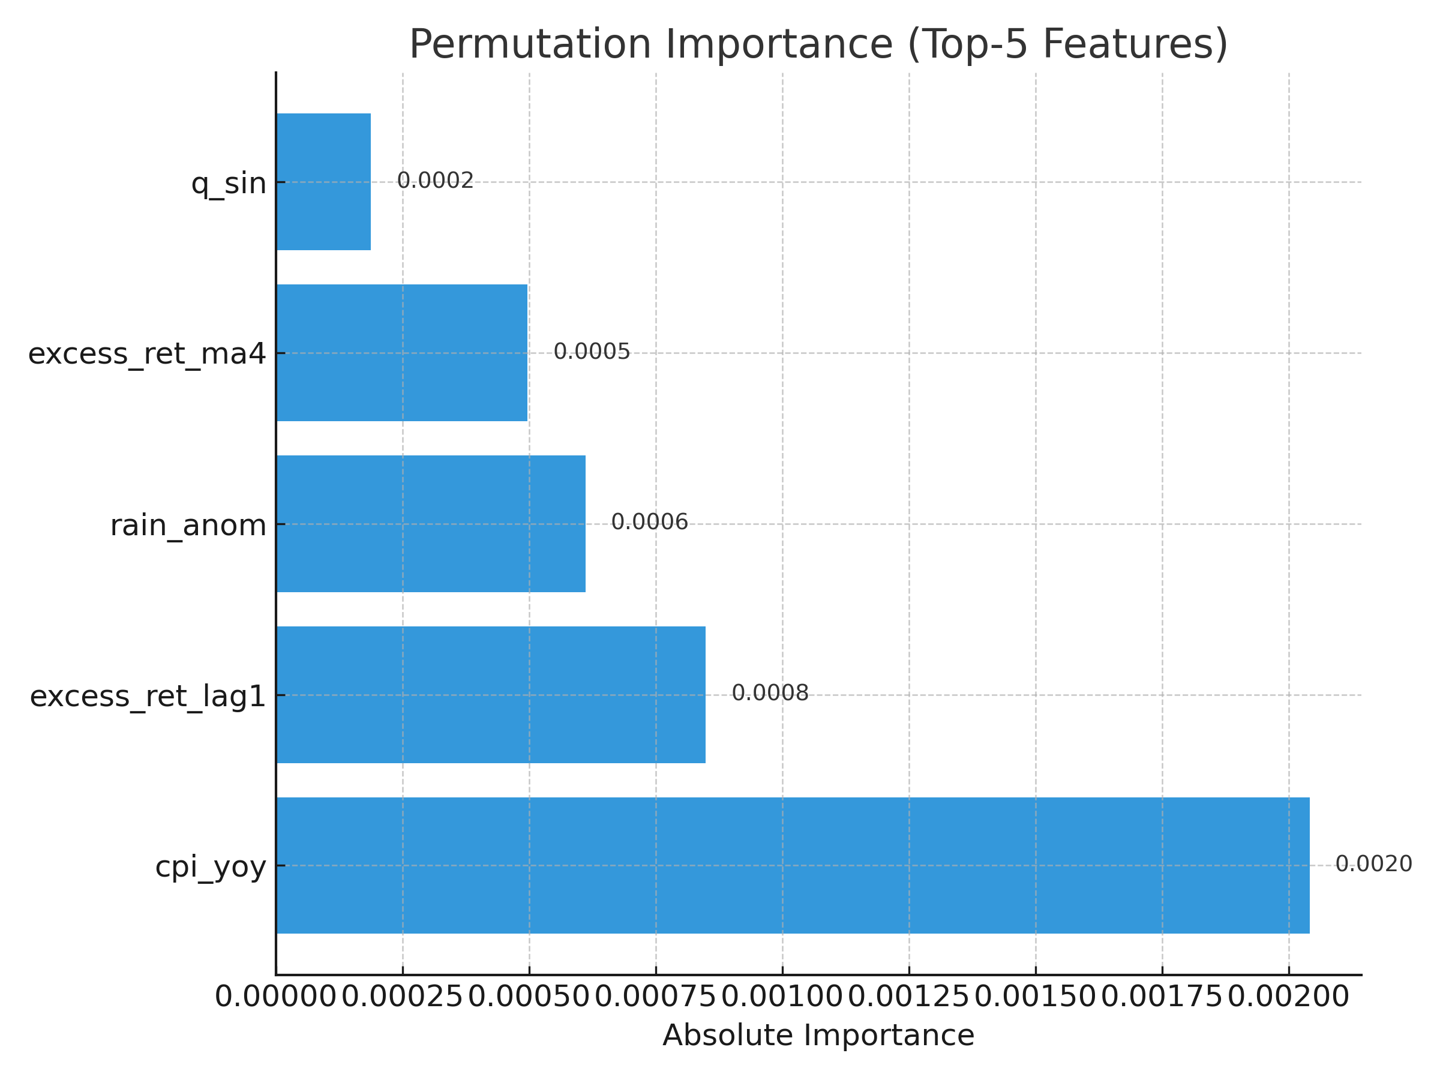
Results
Interpretation – Permutation Importance
Why it matters:
Identifies which features contribute most (even if weakly) to predictions.
Helps assess whether macro variables add value.
Key Findings:
Momentum signals dominate lagged excess return and moving average show the most predictive value.
Macro variables are weak: CPI and rainfall anomalies add very little explanatory power.
Seasonal terms (q_sin, q_cos) are negligible.

Slide 13
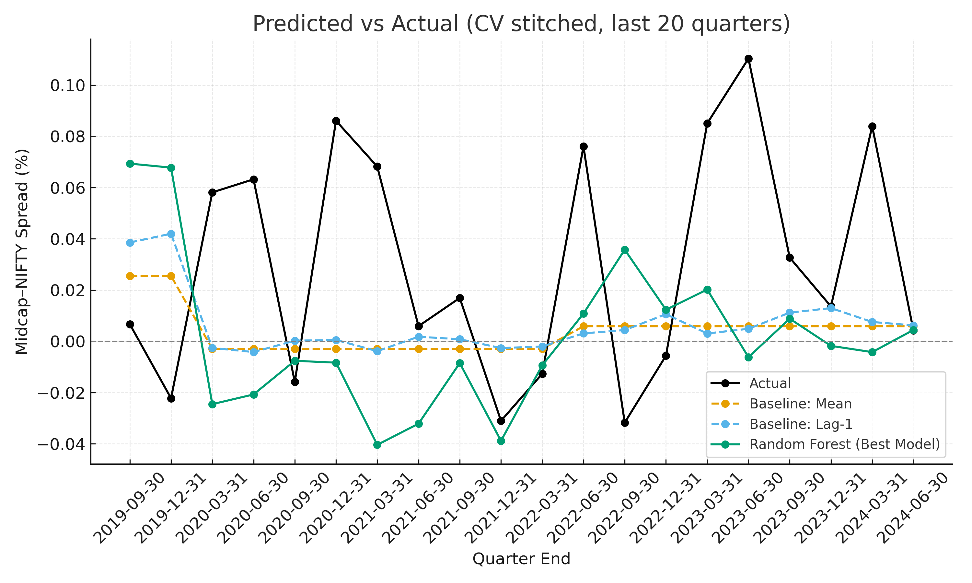
Results
Why it matters:
Visual check of how well models track the true Midcap–NIFTY spread.
Highlights tracking error (gaps between actual and predictions).
Key Findings:
Baselines (mean, lag-1) generally track the spread as well as, or better than, models.
The “best” model (Random Forest) shows visible error and lag vs actuals.
Confirms that machine learning models provide no improvement over baselines.

Slide 14
Results
Interpretation:
Quarterly macro ≠ strong edge: CPI, GDP, repo, and monsoon don’t add reliable power vs naïve yardsticks.
Momentum carries the signal, but not enough to beat a constant mean on error.
Why: Quarterly aggregation blurs timing; effects likely priced or acting at different horizons; small sample (~39) → high variance.

Slide 15
Implementation and User Benefit
For portfolio teams: Keep the baseline as the production default; treat inflation as a light overlay signal (guardrails on position size).
For sell-side: Publish a quarterly “Monsoon + Macro” note translating the latest IMD + CPI prints into scenario commentary.
For policy: Use the framework to discuss climate →growth → equity sensitivity; monitor whether the relationship strengthens with more data.

Slide 16
Conclusion
Conclusion: With the current sample, a simple baseline beats more complex variants. Inflation (YoY) shows the only consistent informational edge; monsoon effects are directional but weak.
Limitations:
Sample size (~39 trainable quarters) → unstable estimates; negative R² vs naïve baselines.
Aggregation & timing: Monsoon stamped at Sep-end and carried; GDP/CPI as YoY quarterly figures; repo moves are stepwise; publication lags matter.
Scope: Relative index spread only; no costs/portfolio construction.
Next steps: Backfill more history, test regime-aware models (e.g., “high-inflation vs low-inflation” regimes), and explore sector-level effects to increase sample size.

Slide 17
Bibliography
India Meteorological Department. (n.d.). All-India rainfall time series. Retrieved September 7, 2025.
Ministry of Statistics & Programme Implementation. (n.d.). Consumer Price Index (Base 2012=100). Retrieved September 7, 2025.
National Statistical Office, MoSPI. (n.d.). Quarterly estimates of GDP at constant (2011–12) prices. Retrieved September 7, 2025.
Reserve Bank of India. (n.d.). Monetary policy — policy repo rate: historical data. Retrieved September 7, 2025.
NSE Indices Limited. (n.d.). NIFTY 50; NIFTY Midcap 100 — historical data. Retrieved September 7, 2025.
(Optional) Academic articles exploring monsoon–GDP and macro–equity relationships (list in notes with year, title, journal, DOI).

